Slide 1
消息传递神经网络预测结果的可解释性
设计
Yang weiwei
Notes:
封面

Slide 2
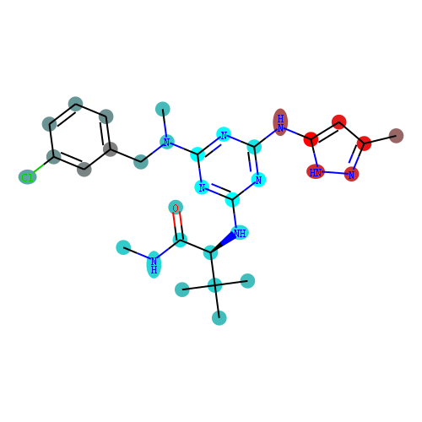
消息传递神经网络中获取分子结构可视化特征
消息传递神经网络中获取分子库分布的可视化特征
0
0.5
1

Slide 3
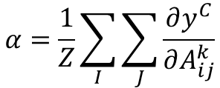
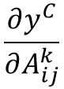
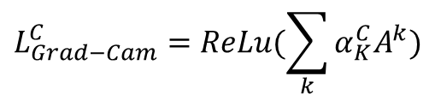
CNN Visual Explanations
Class Activation Map (类激活映射,Grad-CAM)
$$\frac{∂y^{C}}{∂A_{ij}^{k}}$$
Cam/Grad-CAM/ Grad-CAM++
$$α=\frac{1}{Z}\sum_{I}{\sum_{J}{\frac{∂y^{C}}{∂A_{ij}^{k}}}}$$
$$L_{Grad−Cam}^{C}=ReLu(\sum_{k}{α_{K}^{C}A^{k}})$$
Matthew D Zeiler, Rob Fergus. Visualizing and Understanding Convolutional Networks. arXiv:1311.2901, 2013
Jason Yosinski, Jeff Clune, Anh Nguyen, Thomas Fuchs, Hod Lipson. Understanding Neural Networks Through Deep Visualization. arXiv:1506.06579, 2015
Ramprasaath R. Selvaraju, Michael Cogswell, Abhishek Das, Ramakrishna Vedantam, Devi Parikh, Dhruv Batra. Grad-CAM: Visual Explanations from Deep Networks via Gradient-based Localization. arXiv:1610.02391, 2019
Aditya Chattopadhyay, Anirban Sarkar, Prantik Howlader, Vineeth N Balasubramanian.Grad-CAM++: Generalized Gradient-based Visual Explanations for Deep Convolutional Networks. arXiv:1506.06579, 2017

Slide 4
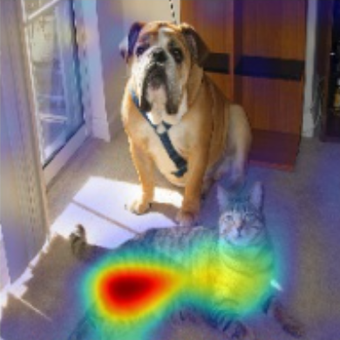
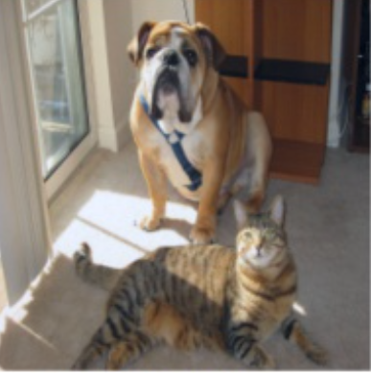
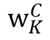
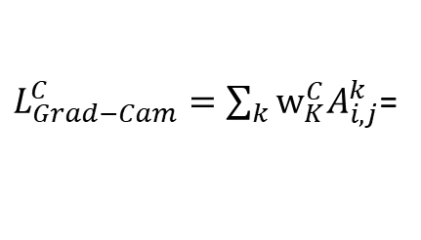
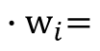
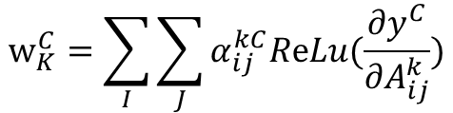
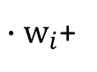
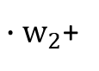
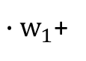
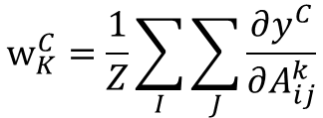
CNN Visual Explanations
Class Activation Map (类激活映射,Grad-CAM)
${∙w}_{1}$+
${∙w}_{2}$+
${∙w}_{i}$+
$${∙w}_{i}=$$
Cam
$$w_{K}^{C}$$
Cat
Dog
$L_{Grad−Cam}^{C}=\sum_{k}{w_{K}^{C}A_{i,j}^{k}}$=
Pool
FC layers
Label
Convolutional layers
Back prop till last convolution layer
$$w_{K}^{C}=\sum_{I}{\sum_{J}{α_{ij}^{kC}ReLu(\frac{∂y^{C}}{∂A_{ij}^{k}})}}$$
Grad-CAM
Ramprasaath R. Selvaraju, Michael Cogswell et.al.
Grad-CAM: Visual Explanations from
Deep Networks via Gradient-based Localization. arXiv:1610.02391, 2019
Aditya Chattopadhyay, Anirban Sarkar, Prantik Howlader,et. al.
Grad-CAM++: Generalized Gradient-based Visual
Explanations for Deep Convolutional Networks. arXiv:1506.06579, 2017
$$w_{K}^{C}=\frac{1}{Z}\sum_{I}{\sum_{J}{\frac{∂y^{C}}{∂A_{ij}^{k}}}}$$
Grad-CAM++

Slide 5
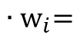
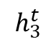
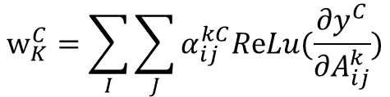
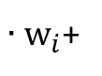
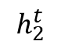
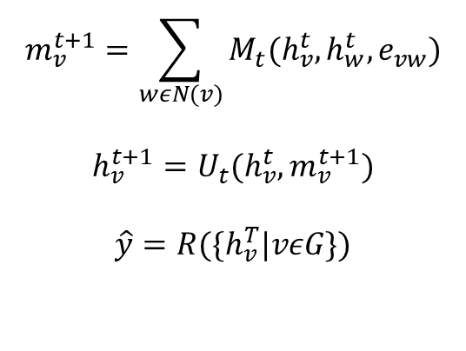
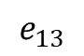
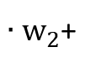
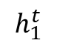
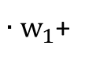
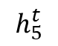
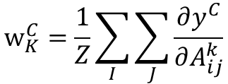
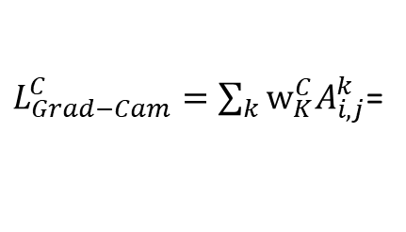
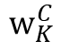
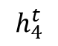
MPNN Visual Explanations
Class Activation Map
${∙w}_{1}$+
${∙w}_{2}$+
${∙w}_{i}$+
$${∙w}_{i}=$$
Cam
$$w_{K}^{C}$$
Inactive
1
$$e_{13}$$
Active
$$h_{1}^{t}$$
$$h_{5}^{t}$$
$L_{Grad−Cam}^{C}=\sum_{k}{w_{K}^{C}A_{i,j}^{k}}$=
3
$$h_{3}^{t}$$
5
FC layers
Label
2
4
Pool
$$m_{v}^{t+1}=\sum_{wεN(v)}{M_{t}(h_{v}^{t},h_{w}^{t},e_{vw})}$$
$$h_{v}^{t+1}=U_{t}(h_{v}^{t},m_{v}^{t+1})$$
$$\hat{y}=R(\{h_{v}^{T}|vεG\})$$
Back prop till last convolution layer
$$w_{K}^{C}=\sum_{I}{\sum_{J}{α_{ij}^{kC}ReLu(\frac{∂y^{C}}{∂A_{ij}^{k}})}}$$
$$h_{2}^{t}$$
$$h_{4}^{t}$$
Grad-CAM
$$w_{K}^{C}=\frac{1}{Z}\sum_{I}{\sum_{J}{\frac{∂y^{C}}{∂A_{ij}^{k}}}}$$
Grad-CAM++
5
Justin Gilmer, Samuel S. Schoenholz et.al.
Neural Message Passing for Quantum Chemistry. arXiv:1704.01212, 2017

Slide 6
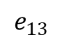
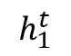
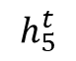
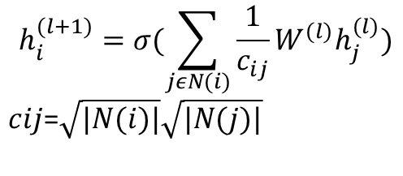
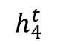
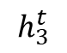
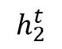
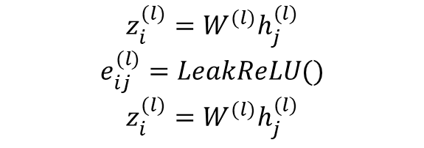
MPNN Theory
Class Activation Map (类激活映射,Grad-CAM)
要解决什么问题
GNN/GAT/ GCN
1
$$e_{13}$$
$$h_{1}^{t}$$
$$h_{5}^{t}$$
基于谱
基于域
3
$$h_{3}^{t}$$
5
$$h_{i}^{(l+1)}=σ(\sum_{jεN(i)}{\frac{1}{c_{ij}}}W^{(l)}h_{j}^{(l)})$$
$c﷮ij$=$\sqrt{|N(i)|}\sqrt{|N(j)|}$
2
4
$$z_{i}^{(l)}=W^{(l)}h_{j}^{(l)}$$
$$e_{ij}^{(l)}=LeakReLU()$$
$$z_{i}^{(l)}=W^{(l)}h_{j}^{(l)}$$
$$h_{2}^{t}$$
$$h_{4}^{t}$$
Matthew D Zeiler, Rob Fergus. Visualizing and Understanding Convolutional Networks. arXiv:1311.2901, 2013
Jason Yosinski, Jeff Clune, Anh Nguyen, Thomas Fuchs, Hod Lipson. Understanding Neural Networks Through Deep Visualization. arXiv:1506.06579, 2015
Ramprasaath R. Selvaraju, Michael Cogswell, Abhishek Das, Ramakrishna Vedantam, Devi Parikh, Dhruv Batra. Grad-CAM: Visual Explanations from Deep Networks via Gradient-based Localization. arXiv:1610.02391, 2019
Aditya Chattopadhyay, Anirban Sarkar, Prantik Howlader, Vineeth N Balasubramanian.Grad-CAM++: Generalized Gradient-based Visual Explanations for Deep Convolutional Networks. arXiv:1506.06579, 2017

Slide 7
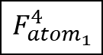
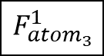
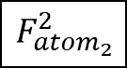
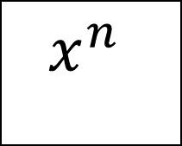
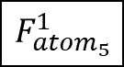

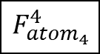

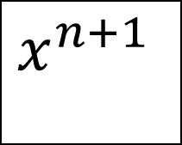
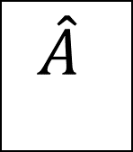
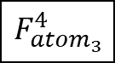
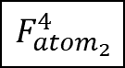
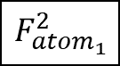




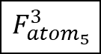
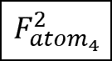





$$F_{{atom}_{1}}^{1}$$
$$\hat{A}$$
$$x^{n}$$
W
$$x^{n+1}$$
$$F_{{atom}_{1}}^{2}$$
$$F_{{atom}_{3}}^{1}$$
$$F_{{atom}_{5}}^{1}$$
$$F_{{atom}_{1}}^{3}$$
$$F_{{atom}_{3}}^{2}$$
$$F_{{atom}_{5}}^{2}$$
$$F_{{atom}_{1}}^{4}$$
1
$$F_{{atom}_{3}}^{3}$$
$$F_{{atom}_{5}}^{3}$$
$$F_{{atom}_{3}}^{4}$$
$$F_{{atom}_{5}}^{4}$$
3
5
$$F_{{atom}_{2}}^{1}$$
2
4
$$F_{{atom}_{2}}^{2}$$
$$F_{{atom}_{4}}^{1}$$
$$x^{n+1}$$
$$F_{{atom}_{2}}^{3}$$
$$F_{{atom}_{4}}^{2}$$
$$F_{{atom}_{2}}^{4}$$
$$F_{{atom}_{4}}^{3}$$
$$F_{{atom}_{4}}^{4}$$

Slide 8

Test 387

Slide 9







































$F_{{atom}_{1}}^{1},F_{{atom}_{1}}^{2}$,…, $F_{{atom}_{1}}^{n}$
$$F_{{atom}_{2}}^{1},F_{{atom}_{2}}^{2}\text{,…, }F_{{atom}_{2}}^{n}$$
$$x=$$
$F_{{atom}_{3}}^{1},F_{{atom}_{3}}^{2}$,…, $F_{{atom}_{3}}^{n}$
$F_{{atom}_{4}}^{1},F_{{atom}_{4}}^{2}$,…, $F_{{atom}_{4}}^{n}$
$F_{{atom}_{5}}^{1},F_{{atom}_{5}}^{2}$,…, $F_{{atom}_{5}}^{n}$
1
3
5
$$F_{{atom}_{1}}^{1}$$
$$F_{{atom}_{1}}^{2}$$
$$F_{{atom}_{1}}^{n}$$
2
4
$$F_{{atom}_{2}}^{1}$$
$$F_{{atom}_{2}}^{2}$$
$$F_{{atom}_{2}}^{n}$$
$$F_{{atom}_{3}}^{1}$$
$$F_{{atom}_{3}}^{2}$$
…
$$F_{{atom}_{3}}^{n}$$
$$F_{{atom}_{4}}^{1}$$
$$F_{{atom}_{4}}^{2}$$
$$F_{{atom}_{4}}^{n}$$
$$F_{{atom}_{5}}^{1}$$
$$F_{{atom}_{5}}^{2}$$
$$F_{{atom}_{5}}^{n}$$
$$F_{{atom}_{1}}^{1}$$
$$F_{{atom}_{1}}^{1}$$
$$F_{{atom}_{1}}^{1}$$
$$F_{{atom}_{2}}^{1}$$
$$F_{{atom}_{2}}^{1}$$
$$F_{{atom}_{2}}^{1}$$
$$F_{mean}^{1}=mean$$
$$F_{{atom}_{3}}^{1}$$
$$F_{mean}^{2}=mean$$
$$F_{{atom}_{3}}^{1}$$
…
$$F_{mean}^{n}=mean$$
$$F_{{atom}_{3}}^{1}$$
$$F_{{atom}_{4}}^{1}$$
$$F_{{atom}_{4}}^{1}$$
$$F_{{atom}_{4}}^{1}$$
$$F_{{atom}_{5}}^{1}$$
$$F_{{atom}_{5}}^{1}$$
$$F_{{atom}_{5}}^{1}$$

Slide 10
























































$$\sum_{i}^{n}{F_{mean}^{i}∙}W_{T}^{i}$$
$$W_{T}^{1}$$
$$W_{F}^{1}$$
.
$$W_{T}^{2}$$
$$W_{F}^{2}$$
$$a_{T}$$
$$F_{mean}^{1}$$
$$F_{mean}^{2}$$
…
$$F_{mean}^{n}$$
…
…
$$a_{F}$$
$$\sum_{i}^{n}{F_{mean}^{i}∙}W_{F}^{i}$$
$$W_{T}^{3}$$
$$W_{F}^{3}$$
…
$$F_{{atom}_{1}}^{1}$$
$$F_{{atom}_{1}}^{2}$$
$$F_{{atom}_{1}}^{n}$$
$$F_{{atom}_{1}}^{1}$$
$$F_{{atom}_{1}}^{2}$$
$$F_{{atom}_{1}}^{n}$$
$$f_{{atom}_{1}}^{T}$$
$$F_{{atom}_{2}}^{1}$$
$$F_{{atom}_{2}}^{2}$$
$$F_{{atom}_{2}}^{n}$$
$$F_{{atom}_{2}}^{1}$$
$$F_{{atom}_{2}}^{2}$$
$$F_{{atom}_{2}}^{n}$$
$$f_{{atom}_{2}}^{T}$$
$$F_{{atom}_{3}}^{1}$$
$$F_{{atom}_{3}}^{2}$$
…
$$F_{{atom}_{3}}^{n}$$
$$F_{{atom}_{3}}^{1}$$
${∙W}_{T}^{1}$+
$$F_{{atom}_{3}}^{2}$$
${∙W}_{T}^{1}$+$⋯$
$$F_{{atom}_{3}}^{n}$$
$${∙W}_{T}^{1}$$
$$f_{{atom}_{3}}^{T}$$
$$F_{{atom}_{4}}^{1}$$
$$F_{{atom}_{4}}^{2}$$
$$F_{{atom}_{4}}^{n}$$
$$F_{{atom}_{4}}^{1}$$
$$F_{{atom}_{4}}^{2}$$
$$F_{{atom}_{4}}^{n}$$
$$f_{{atom}_{4}}^{T}$$
$$F_{{atom}_{5}}^{1}$$
$$F_{{atom}_{5}}^{2}$$
$$F_{{atom}_{5}}^{n}$$
$$F_{{atom}_{5}}^{1}$$
$$F_{{atom}_{5}}^{2}$$
$$F_{{atom}_{5}}^{n}$$
$$f_{{atom}_{5}}^{T}$$
$$f_{{atom}_{1}}^{T}$$
1
$$f_{{atom}_{3}}^{T}$$
$$f_{{atom}_{5}}^{T}$$
3
5
$$f_{{atom}_{2}}^{T}$$
2
4
$$f_{{atom}_{4}}^{T}$$

Slide 11





















































$$F_{{atom}_{1}}^{1}$$
$$F_{{atom}_{1}}^{2}$$
$$F_{{atom}_{1}}^{n}$$
$$F_{{atom}_{1}}^{1}$$
$$F_{{atom}_{1}}^{2}$$
$$F_{{atom}_{1}}^{n}$$
$$f_{{atom}_{1}}^{F}$$
$$F_{{atom}_{2}}^{1}$$
$$F_{{atom}_{2}}^{2}$$
$$F_{{atom}_{2}}^{n}$$
$$F_{{atom}_{2}}^{1}$$
$$F_{{atom}_{2}}^{2}$$
$$F_{{atom}_{2}}^{n}$$
$$f_{{atom}_{2}}^{F}$$
$$F_{{atom}_{3}}^{1}$$
$$F_{{atom}_{3}}^{2}$$
…
$$F_{{atom}_{3}}^{n}$$
$$F_{{atom}_{3}}^{1}$$
${∙W}_{F}^{1}$+
$$F_{{atom}_{3}}^{2}$$
${∙W}_{F}^{1}$+$⋯$
$$F_{{atom}_{3}}^{n}$$
$${∙W}_{F}^{1}$$
$$f_{{atom}_{3}}^{F}$$
$$F_{{atom}_{4}}^{1}$$
$$F_{{atom}_{4}}^{2}$$
$$F_{{atom}_{4}}^{n}$$
$$F_{{atom}_{4}}^{1}$$
$$F_{{atom}_{4}}^{2}$$
$$F_{{atom}_{4}}^{n}$$
$$f_{{atom}_{4}}^{F}$$
$$F_{{atom}_{5}}^{1}$$
$$F_{{atom}_{5}}^{2}$$
$$F_{{atom}_{5}}^{n}$$
$$F_{{atom}_{5}}^{1}$$
$$F_{{atom}_{5}}^{2}$$
$$F_{{atom}_{5}}^{n}$$
$$f_{{atom}_{5}}^{F}$$
$$f_{{atom}_{1}}^{T}$$
$$f_{{atom}_{1}}^{F}$$
$$f_{{atom}_{1}}^{}$$
1
$$f_{{atom}_{3}}^{T}$$
1
$$f_{{atom}_{3}}^{F}$$
$$f_{{atom}_{5}}^{T}$$
1
$$f_{{atom}_{3}}^{}$$
$$f_{{atom}_{5}}^{F}$$
$$f_{{atom}_{5}}^{}$$
3
5
3
5
3
5
2
4
$$f_{{atom}_{4}}^{T}$$
2
4
$$f_{{atom}_{4}}^{F}$$
2
4
$$f_{{atom}_{4}}^{}$$
$$f_{{atom}_{2}}^{T}$$
$$f_{{atom}_{2}}^{F}$$
$$f_{{atom}_{2}}^{}$$

Slide 12
0
0.5
1
天蓝色：认为该原子对分子被判定为活性分子有消极贡献
亮红色：认为该原子对分子被判定为活性分子有积极贡献

Slide 13
Training data 4000 Test data 387
Has binding strength information
Training data 40387
Test data 387
No binding strength information
Valid data 100
Valid data 100

Slide 14


Slide 15













$$y=−x+b$$
$$y=x$$
从图卷积神经网络中获取分子结构可视化特征
从预测结果获取数据分布特征
$$y=x+b$$

Slide 16













$$y=−x+b$$
$$y=x$$
从图卷积神经网络中获取分子结构可视化特征
$$y=x+b$$
从预测结果获取数据分布特征

Slide 17












Slide 18

0
0.5
1
天蓝色：认为该原子对分子被判定为活性分子有消极贡献
亮红色：认为该原子对分子被判定为活性分子有积极贡献

Slide 19
Thanks for your attention!
Faster Drug Discovery

